Slide 1
Australian Labor Market and Twitter Analysis (2022)
Team 66:
Wentao Xie
Maxie Ren
Fan Zhang
Qingtan Shen
Yang Meng
Notes:
Most of what I am talking about is covered in the guidelines for use, found at the front of the RDA.

Slide 2
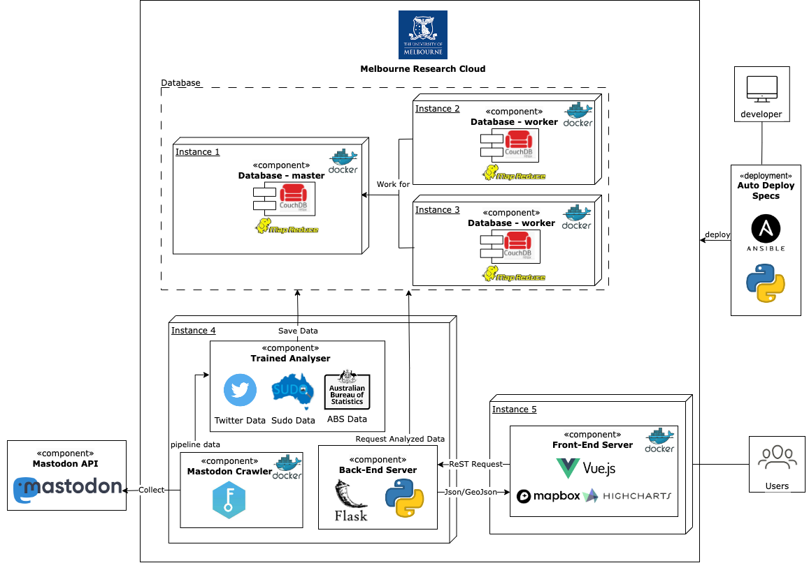
System Architect

Slide 3
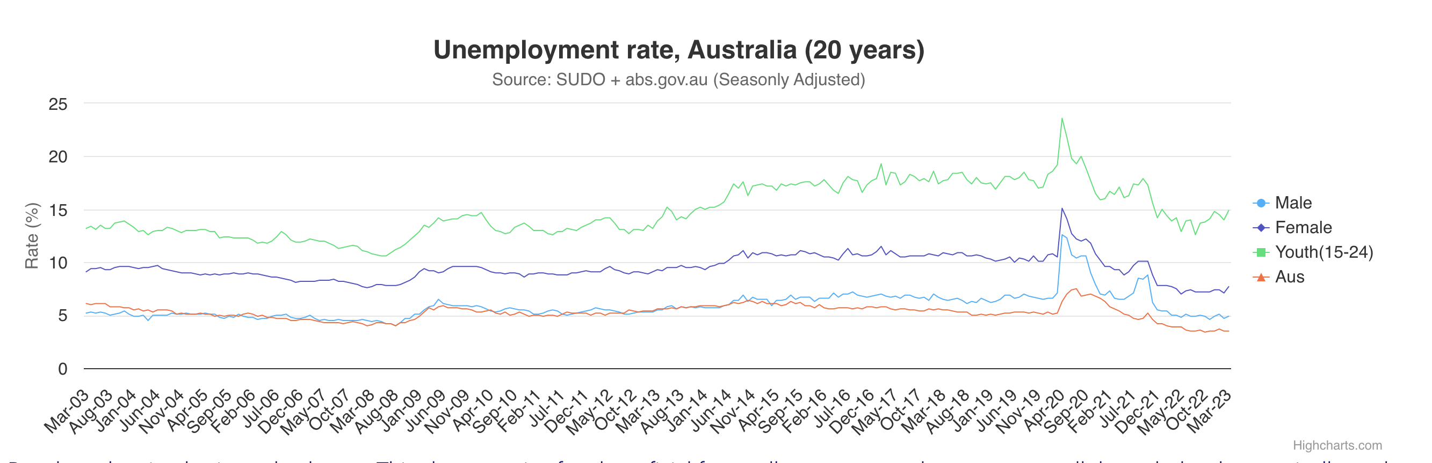
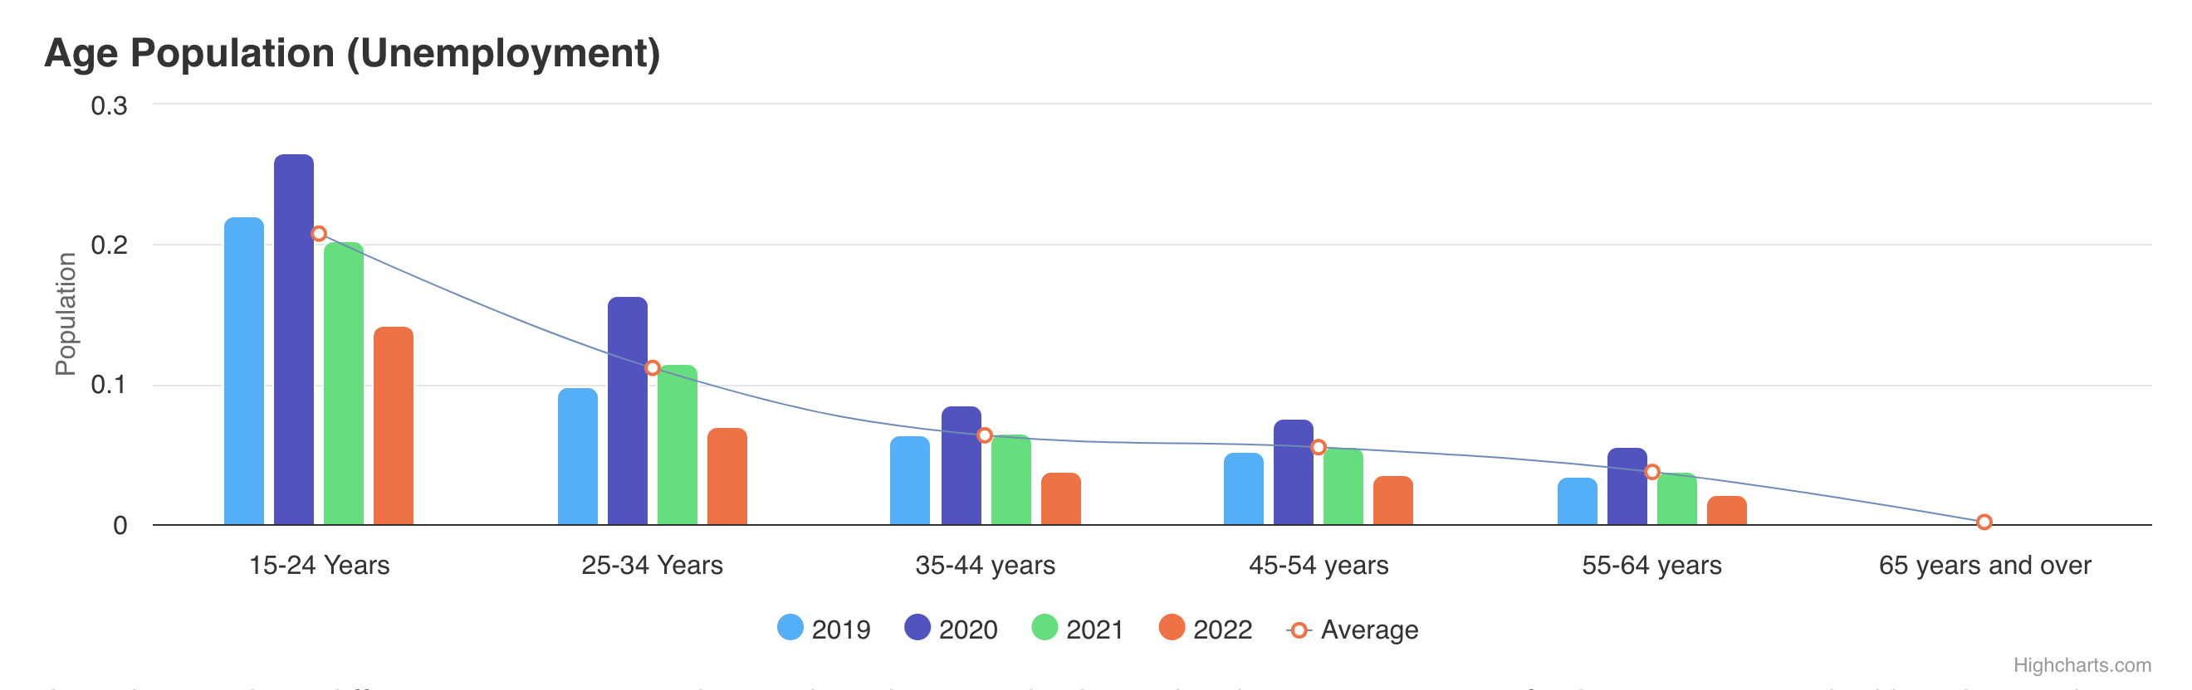
Scenario 1: 20-year unemployment rate.
Assumptions:
Findings:
- New Grads loss their jobs.

Slide 4
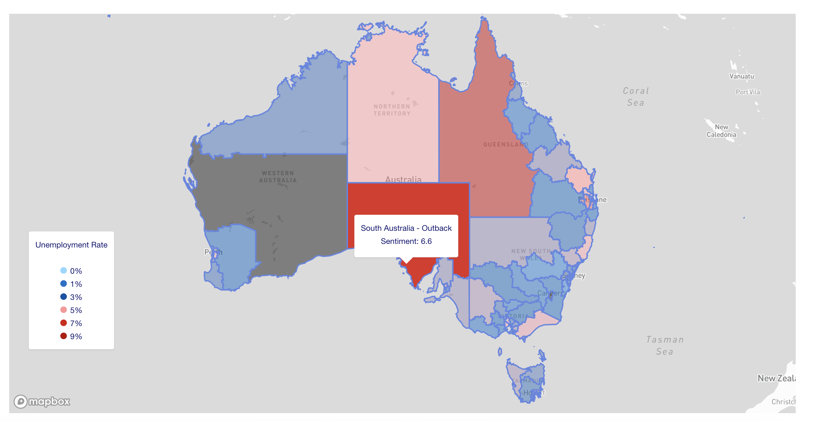
Scenario 2 Regional Analysis (2022 only)

Slide 5
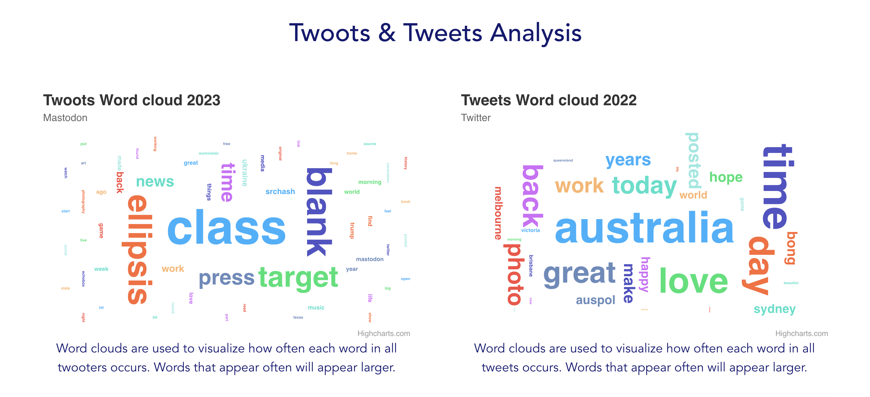
Scenario 3

